Slide 1

Chatting Application Using Java Core and Server Socket
Project Mentor Name
Mr. Ankit Verma

Slide 2
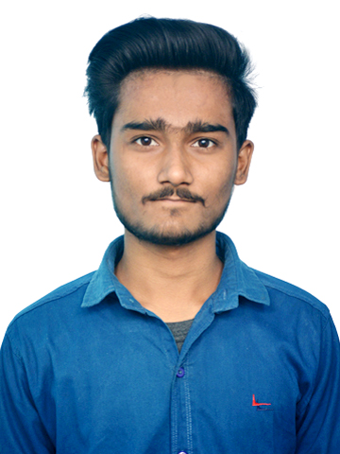
PROJECT DEVELOPER
Rajat saxena
Master of computer application
2000290140097

Slide 3
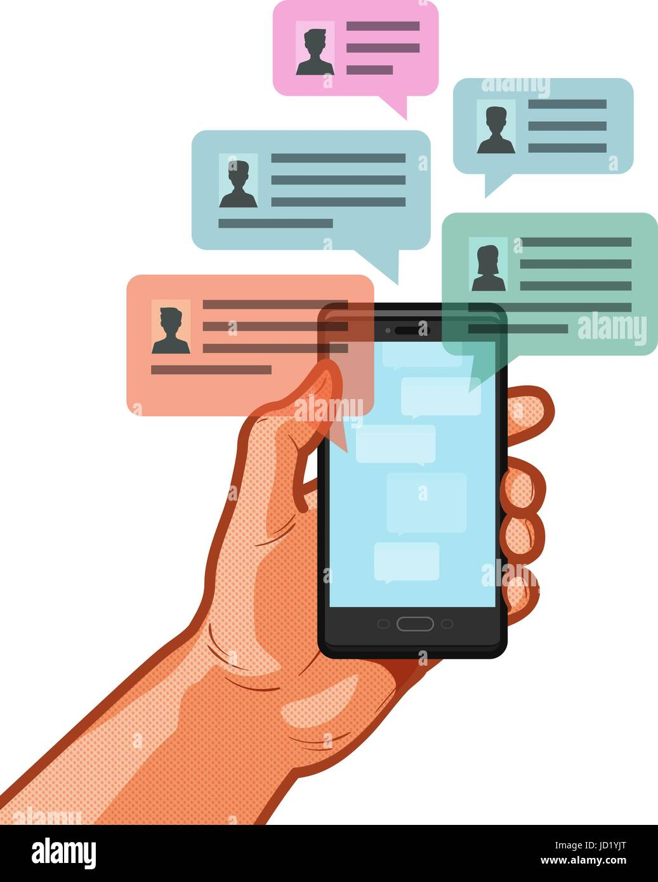
Introduction
Chatting Application is a Desktop based application.
This client server chat application is based on java swing and used socket package.
Chatting is a method of using technology to bring people and ideas “together” despite of the geographical barriers.

Slide 4

Technology
Programming Language: Java
User Interface
Swing API
AWT(Abstract Windowing Toolkit) API
File handling
SOCKET PROGRAMMING

Slide 5
MAIN OBJECTIVE
The aim of this project is to express how we can implement a simple chat application between a server and a client?
The application is a Desktop based application and is implemented using Swing and AWT. The project is developed in Java SE language executed on a single stand-alone java across a network using loop back address concept.
Application consists of two programs:
Server
Client

Slide 6
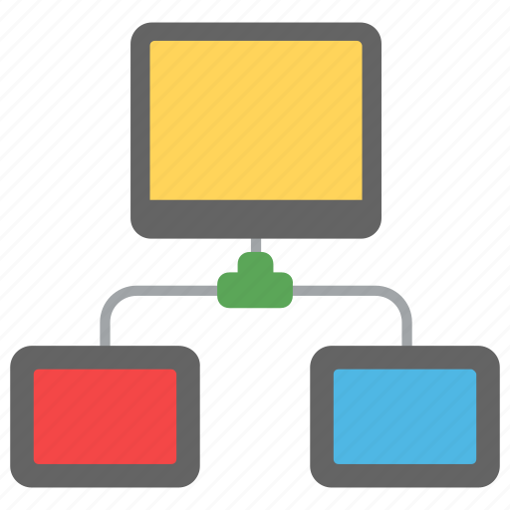
Module
Server Module
Client Module
The server module of the application waits for the client to connect to it.
Then if connection is granted a client interacts communicates and connects to the server, it can mutually communicate with the server.
The duty of the server is to let clients exchange the messages.
The client module is the one that utilizer sends requests to the server.
Utilizer utilizes the client as the means to connect to the server.
Once he establishes the connection, he can communicate to the connected server.

Slide 7
Operational Concepts and Scenarios
Operation of the application based on the inputs given by the user:
When the run button is clicked then the chat form is initialized with a connection between the host and the client machine.
Note: server must be started at first before a client start.
Contains a rich textbox which send messages from one user to another.
Contains a textbox for messages to be written that is sent across the network.
Contains a Send button
When the sent button is clicked, in the background, the text in the textbox is encoded sent as a packet over the network to the client machine. Here this message is decoded and is shown in the rich textbox.

Slide 8
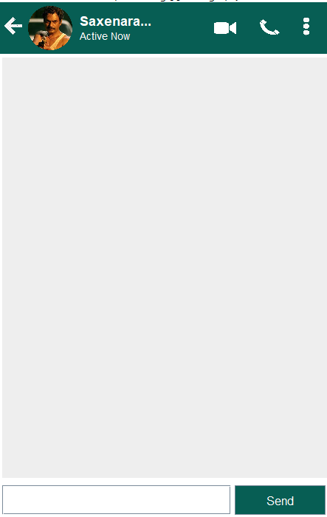
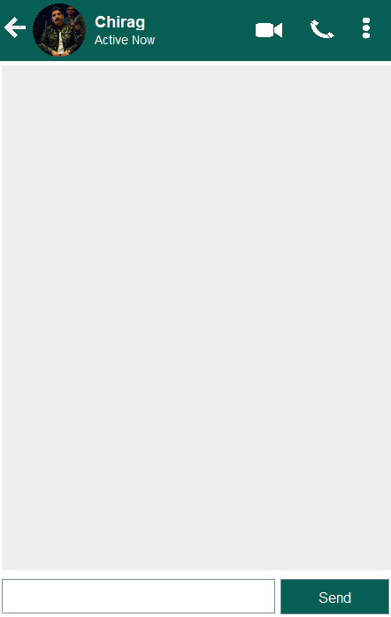
Server Screen
Client Screen

Slide 9
Future work
There is always a room for improvements in any software package, however good and efficient it may be done. But the most important thing should be flexible to accept further modification. Right now we are just dealing with text communication. In future this software may be extended to include features such as:
Files transfer: this will enable the user to send files of different formats to others via the chat∙ application.
Voice chat: this will enhance the application to a higher level where communication will be∙ possible via voice calling as in telephone.

Slide 10


